Slide 1
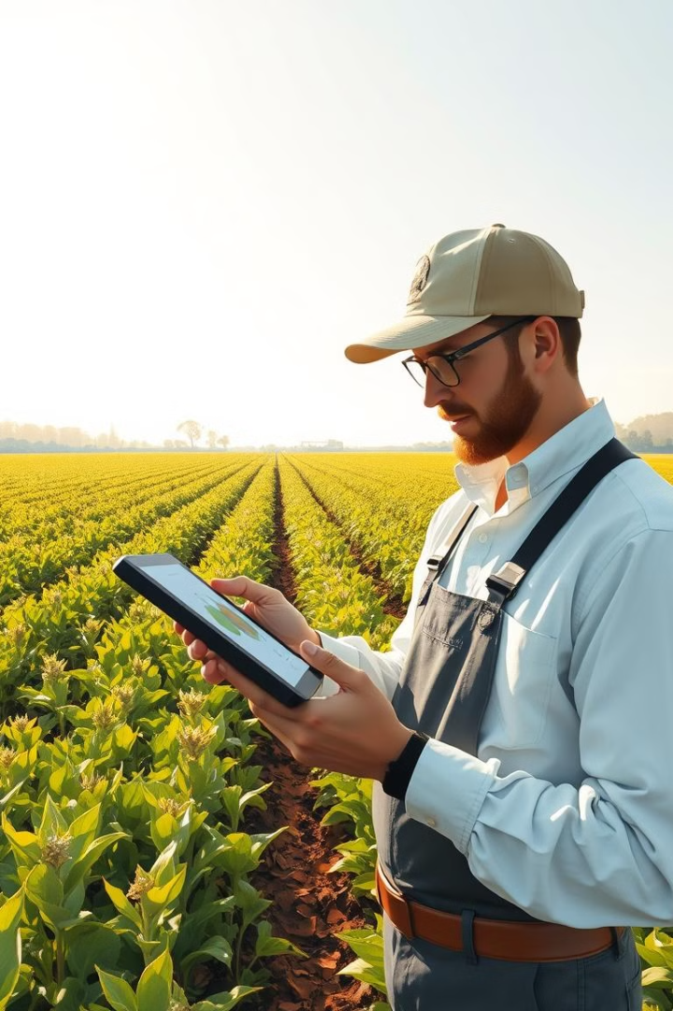
Crop Disease Prediction Project
This project aims to develop a user-friendly web application for predicting crop diseases. Using machine learning techniques, the system analyzes images of crops to identify diseases and provide potential solutions.
Presenter - Prasad Kanakgiri
Institution – Vishwakarma Institute of Information Technology
Location - Pune

Slide 2

Introduction
Introduction to Crop Diseases
Economic Impact
Challenges in Disease Detection
Need for Technological Solutions

Slide 3

Objective:
To Develop a Machine Learning Model for Accurately Predicting Crop Diseases from Images
1. Use of Machine Learning
2. Image-Based Disease Detection
3. Benefits:
Accuracy
Scalability
Accessibility
4. Ultimate Goal

Slide 4
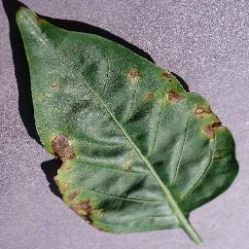
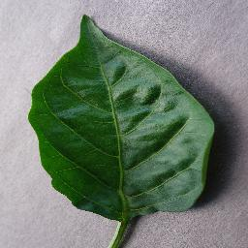
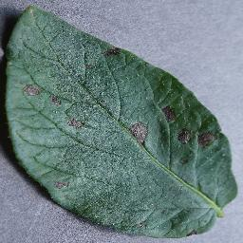
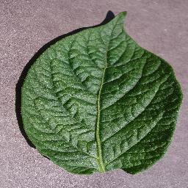
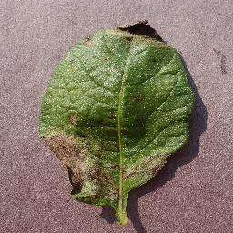
Dataset Overview
Dataset Used: PlantVillage Dataset
The PlantVillage dataset is a publicly available dataset that consists of labeled images of healthy and diseased crop leaves. It is widely used for research in plant disease detection using machine learning.
Classes:
Pepper__bell___Bacterial_spot
Pepper__bell___healthy
Potato___Early_blight
Potato___healthy
Potato___Late_blight
Total Images: 4,627 Images
Data Split:
Training Set: 80% of the images (3,703 images) are used for training the model to learn patterns and features.
Validation Set: 20% of the images (924 images) are used for validating the model's performance and ensuring it generalizes well to unseen data.

Slide 5

Data Collection and Preprocessing
The project begins by gathering a comprehensive dataset of crop images. This dataset includes healthy and diseased crops, annotated with disease labels.
1
Data Sources
2
Image Resizing
Diverse sources, including online repositories, research institutions, and field data, are leveraged to ensure dataset diversity and representativeness.
All images are resized to 150x150 pixels to maintain uniform input size, reducing computational complexity and speeding up training while preserving image details.
3
Data Augmentation
4
Normalization
The pixel values of all images are normalized to a range between 0 and 1. This is achieved by dividing each pixel value by 255, which helps in faster convergence of the model by standardizing the input data.
To increase dataset size and diversity, techniques such as image rotation, flipping, and scaling are applied to generate synthetic data.

Slide 6
Model Training and Evaluation
A CNN model is used for feature extraction and classification of crop diseases from images.
Conv2D and MaxPooling Layers: Extract spatial features and reduce dimensionality.
Dense and Dropout Layers: Learn complex patterns and prevent overfitting.
Activation Functions: ReLU for hidden layers and Softmax for the output layer to classify images into 5 disease categories.
Model Training
Hyperparameter Tuning
Evaluation Metrics
20 epochs with data augmentation, approximately 65 seconds per epoch,
This approach optimizes training speed and accuracy
The model's hyperparameters, such as learning rate, batch size, and number of layers, are adjusted to maximize the model's performance.
Metrics such as accuracy, precision, recall, and F1-score are used to evaluate the model's ability to classify different crop diseases.

Slide 7
Model Performance
Final Test Accuracy: 97.94%
The model achieved a high test accuracy of 97.94%, demonstrating strong performance in correctly identifying crop diseases from images.

Slide 8
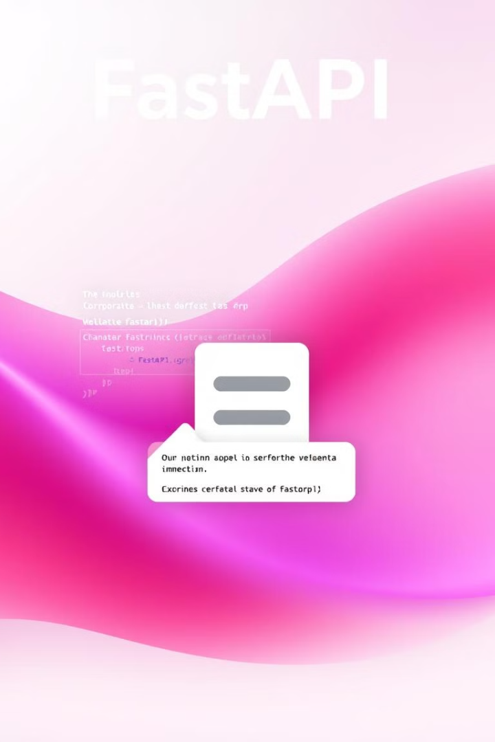
FastAPI Backend Development
FastAPI is used to create a robust and efficient backend API that handles user requests and provides predictions based on the trained model.
API Endpoints
Data Handling
Endpoints are defined to handle different requests, such as image upload, prediction requests, and data retrieval.
The API handles image uploads, data validation, preprocessing, and model inference.
Response Formatting
Predictions and responses are formatted in a standardized format, such as JSON, for easy consumption by the frontend.

Slide 9
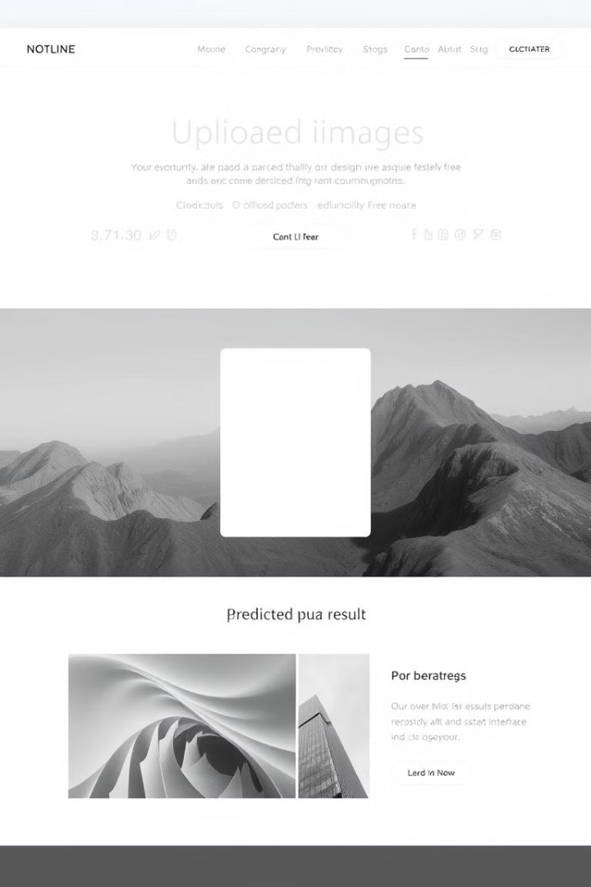
HTML and CSS for Frontend
A user-friendly frontend is developed using HTML and CSS to provide an intuitive interface for users to upload images and view predictions.
1
Image Upload
An easy-to-use image upload button allows users to select and upload images of crops for analysis.
2
Prediction Display
The predicted results are displayed in a clear and concise manner, including the identified disease and potential solutions.
3
User Feedback
The frontend provides feedback to the user, indicating the status of the prediction process and any potential errors.

Slide 10




JavaScript for Frontend Interactivity
JavaScript is used to add interactivity and dynamic functionality to the frontend, enhancing the user experience.
Image Upload Handling
JavaScript code handles image uploads, validation, and preprocessing before sending the image to the backend.
API Communication
JavaScript makes asynchronous requests to the FastAPI backend to get predictions for the uploaded images.
Displaying Results
JavaScript dynamically updates the frontend with the prediction results, including the identified disease and potential solutions.

Slide 11
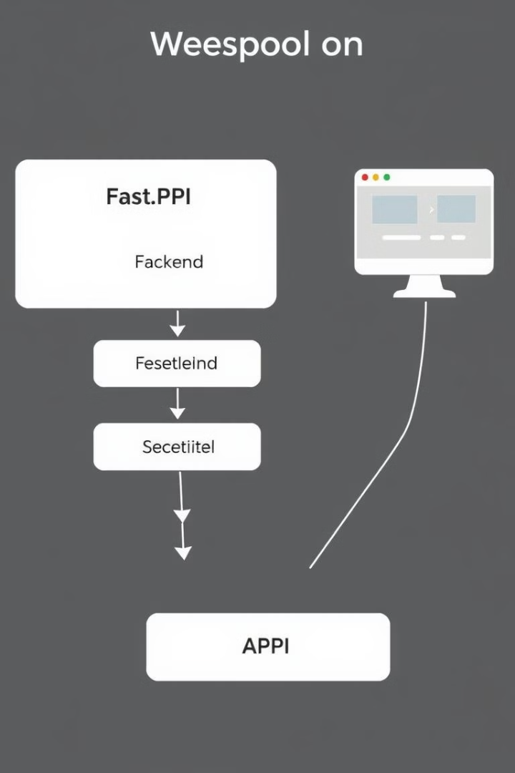
Integrating the Backend and Frontend
The backend API and frontend are seamlessly integrated to create a cohesive user experience.
Backend
Frontend
Handles image uploads and preprocessing
Provides image upload interface
Performs model inference and generates predictions
Displays predictions and potential solutions
Responds to frontend requests with prediction results
Sends user requests to the backend

Slide 12
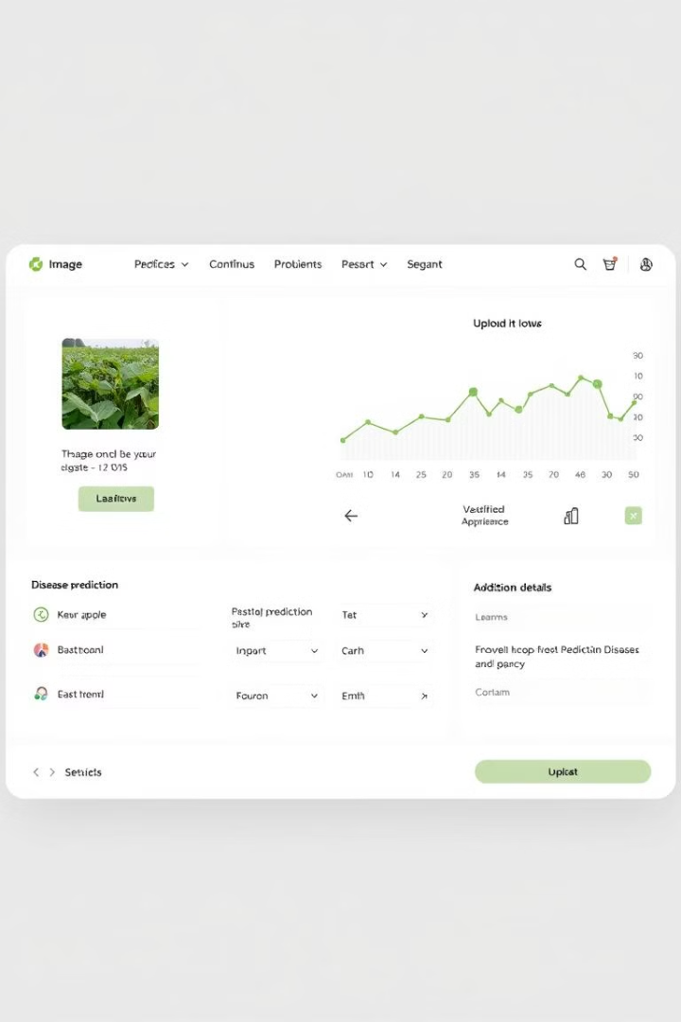
Handling User Inputs and Predictions
The application handles user inputs, such as uploaded images, and provides accurate and timely predictions.
1
Image Validation
2
Prediction Processing
The application validates user inputs to ensure that the uploaded images meet the required format and quality.
Once validated, the images are sent to the backend for processing and prediction by the trained model.
3
Result Presentation
Predictions are presented to the user in a clear and concise manner, along with potential solutions and recommendations.

Slide 13


Slide 14
Challenges Faced
Technical Challenges:
Data Imbalance:
Issue: Some crop disease categories had significantly fewer images than others.
Solution: Used data augmentation techniques (like rotation, flipping, zoom) to artificially increase the size of underrepresented classes

Slide 15
Challenges Faced
Technical Challenges:
Model Overfitting:
Issue: The model performed well on training dataset but poorly on validation initially.
Solution: Used dropout layers in the network and used data augmentation to enhance model generalization and prevent overfitting.

Slide 16
Learnings
Technical Skills:
Machine Learning: Gained hands-on experience in building and optimizing a CNN for image classification.
FastAPI: Learned to develop a robust backend API for image processing and disease prediction.
Deployment: Understood the process of deploying machine learning models and APIs to production.

Slide 17
Learnings
Project Management:
Time Management: Effectively managed time to balance multiple aspects of the project, from model training to API development.
Problem-Solving: Developed strategies to tackle challenges like data imbalance and model overfitting.
Teamwork: Collaborated effectively with the peers to meet project objectives and deadlines.

Slide 18
Conclusion and Future Enhancements
Key Take Aways
Successfully developed a crop disease prediction model with high accuracy (97.94%) using deep learning techniques.
Created a user-friendly backend API using FastAPI for seamless integration and deployment.
Addressed challenges like data imbalance and overfitting, enhancing model robustness and generalization.
Future Enhancements
Expand the model to cover a wider range of crop diseases.
Optimize the model further for faster predictions and lower computational costs.
Deploy the solution on a scalable cloud platform to make it accessible to farmers globally.
Final Thought
The project demonstrates the potential of AI in agriculture, contributing to timely disease detection and better crop management.

Slide 19

GitHub :- PrasadKanakgiri (Prasad Kanakgiri) · GitHub
Mail :- kanakgiriprasad26@gmail.com
Thank You

